Slide 1
Intelligent influence
Digital Transformation Agency
Session 1
Facilitator

Slide 3

Acknowledgement
Notes:
2026 statement
I acknowledge the Traditional Owners of all the lands on which we are meeting [insert the recognised custodians – in Canberra where I am joining you from, it is the Ngunnawal and Ngambri people]. I would also like to pay my respects to Elders, past and present. I also acknowledge any Aboriginal and Torres Strait Islander people joining us today.
This is a photo of the Brindabellas south-west of Canberra, the traditional lands of the Ngunnawal and Ngambri people.

Slide 4
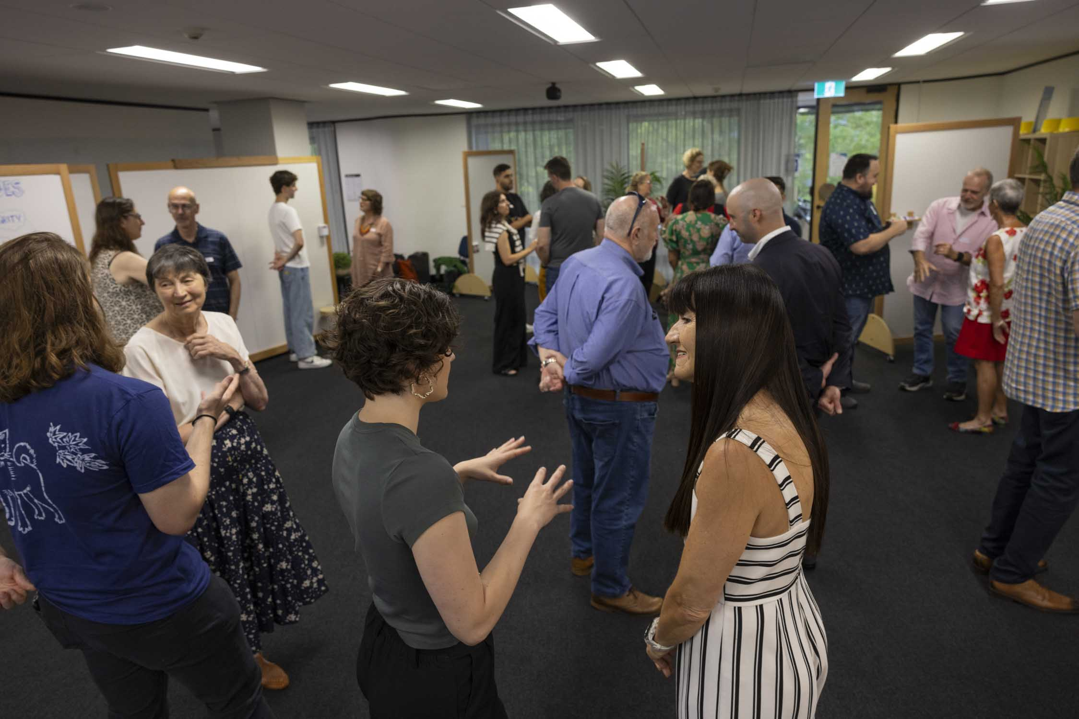
How to get the most out of this session
Keep your workbook open
Join discussions
Dive into problems
Engage with your peers
Listen carefully
Be patient
Encourage others
Notes:
Important - remind participants:
Ethos CRS do not share PowerPoints (unless request for an accessibility accommodation)
Our workbooks are designed to be completed during the workshop so they can be used as a resource following training.
We will cover a lot in this workshop. Because things fade quickly, we recommend you write down those things that have stood out for you.
You may wish to use the section provided at the end of your workbook to do record these notes as we progress through the workshop.
At the end of this workshop think about:
committing to a plan of action - when/where will you be able to apply those things? Identify those and commit to action
following through - it's the doing that makes learning stick, so be sure to do the thing you committed to.
In writing that out it feels a bit lo-fi but I do find it a useful way to round out. Let me know if you've got any questions

Slide 5
Your feedback is important to us
Thank you for taking a moment at the end of this workshop to fill out the evaluation form.
Your facilitator or department contact will share the link with you.
Notes:
Your feedback is really important!
FACILITATORS – IF WE DISTRIBUTE THE LINKS, THEY CAN BE FOUND IN THE CALENDAR EVENT. PLEASE COPY AND PASTE THIS LINK INTO THE CHAT NOW.
Otherwise the calendar event should indicate if the evals are self administrated through the client contact.

Slide 6
Learning objectives
After attending Intelligent influence, you will be better able to:
use frameworks and tools to influence strategically and intelligently
identify who you need to influence
develop skills to communicate with impact and influence decision-makers and stakeholders
anticipate challenges and manage risks more effectively
resolve and transform conflict into positive outcomes.

Slide 7
1. What is influence and what
makes an intelligent influencer?

Slide 8
Quote
‘The capacity to have an effect on the character, development, or behaviour of someone or something, or the effect itself’
Influence - Cambridge Dictionary, n.d.
Notes:
Persuasion can be defined as ‘inducing (someone) to do [or believe] something through reasoning or argument’.
Persuasion is transactional, short-term and risks becoming adversarial. Influence is inclusive, based on common goals and values, and underpins productive working relationships.
Next slide reframes influence as an outcome dependent on a tool kit which includes persuasion among other things.

Slide 9

An action and outcome
An effective influencer draws on a toolkit of:
Persuasion
Active listening
Relationship building
Collaboration
Stakeholder awareness
Credibility
Empathy
Questioning
Framing and reframing
Notes:
What else would participants add to this list?
Influence is not just a way to operate; it’s something we achieve. Effective influence comes from the habits, behaviours, and relationships that enable positive outcomes.

Slide 10

Notes:
Sporting teams are a useful parallel to draw when discussing influence.
Obvious influencer may be the coach or captain. But approaches to teamwork and tactics – and attitude – are shaped by:
How teammates play and approach play
How you align with or distance yourself from other players
The strategy of both teams
The attitudes of both teams
How you communicate with players off the field
Opportunities you are afforded as part of the team.

Slide 11
2. What are the DTA’s influencing roles and responsibilities?

Slide 12

Influencing
non-technical audiences
Start with the outcome
Tell the story behind the data
Prioritise key evidence
Understand your audience
Speak your audience's language
Link insights to impact
Make the decision clear
Notes:
One basis for intelligence Influence is to understand technical aspects and then be able to explain those aspects in a plain language way to a non-expert audience or stakeholder.
We’ll explore how to get to these key points throughout today’s workshop.

Slide 13

What gets in the way
of influence?
Unclear or buried purpose
Poor logic
Jumbled sequence
Unsubstantiated claims or incorrect information
Bias or imbalanced views
Basic errors – typos, grammar, incorrect information
Inappropriate tone

Slide 14
3. Understanding your stakeholders

Slide 15

Your stakeholders are
any individual, group or party that has an interest or influence in the work, policies or outcomes of your organisation.

Slide 16

Stakeholder analysis
Why it’s important
  Know who matters and why
  Understand interests, needs and influence
  Identify potential champions and detractors
  Prioritise engagement efforts
  Reduce risks and surprises
  Build support for successful outcomes
Notes:
Stakeholder analysis helps you engage strategically.
Not all stakeholders are affected in the same way. Important to understand their specific needs through stakeholder analysis.

Slide 17
Understand your stakeholders
What stakeholders want
What influences expectations
What are their, goals, needs and concerns?
What outcomes do they value most?
How will your initiative affect them?
What level of involvement do they want?
What policy, regulatory or organisational requirements apply?
How do media and public opinion shape expectations?
What are the community expectations?
What competing interests may affect expectations?
Notes:
To engage effectively – understand both what stakeholders want AND what influences their expectations

Slide 18
4. Stakeholder status and mapping

Slide 19
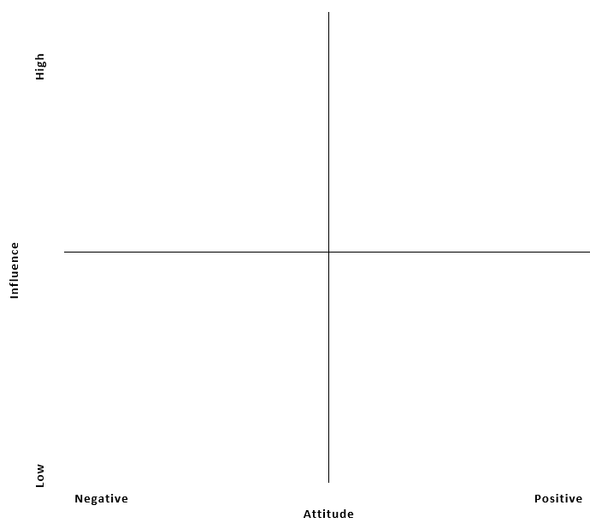
Stakeholder mapping matrix
Influence axis (y):
How much influence does this stakeholder have over the success of the initiative?
How important is their support to achieving the desired outcomes?
Government regulator
Community advocate
Attitude axis (x):
What is their likely view of the initiative?
Are they likely to support, oppose or remain neutral towards the proposed actions?

Slide 20
Stakeholder mapping matrix revisited
Government regulator
X
Community advocate

Slide 21

Shifting stakeholder positions
  Build relationships and trust
  Increase communication and transparency
  Involve stakeholders early in decision-making
  Address concerns and barriers directly
  Demonstrate value and shared benefits
Notes:
Some strategies for moving stakeholders towards success

Slide 22
Short break

Slide 23
5. Communicating with clarity

Slide 24
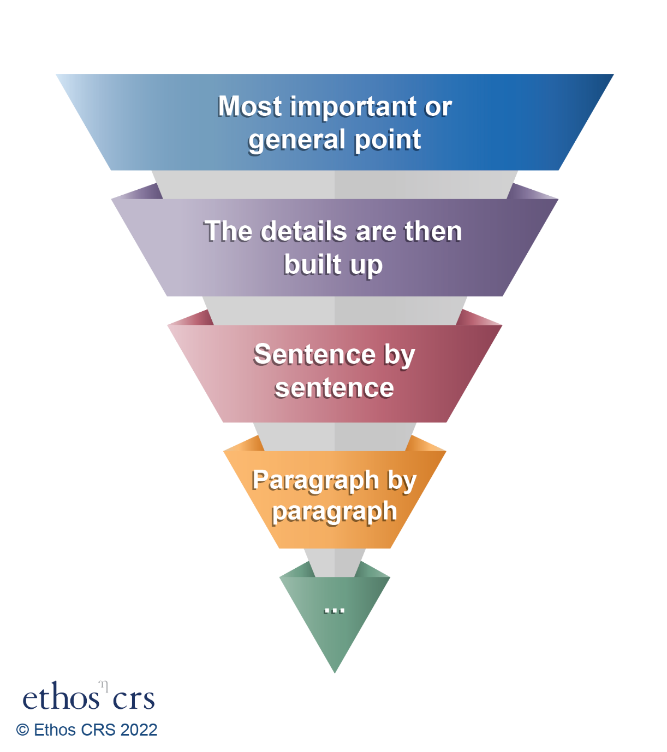
The inverted pyramid
Structure information in order of relevance and importance.
Highlight the main point at the top of your document/start of your presentation or conversation.
Follow with background and rationale.

Slide 25
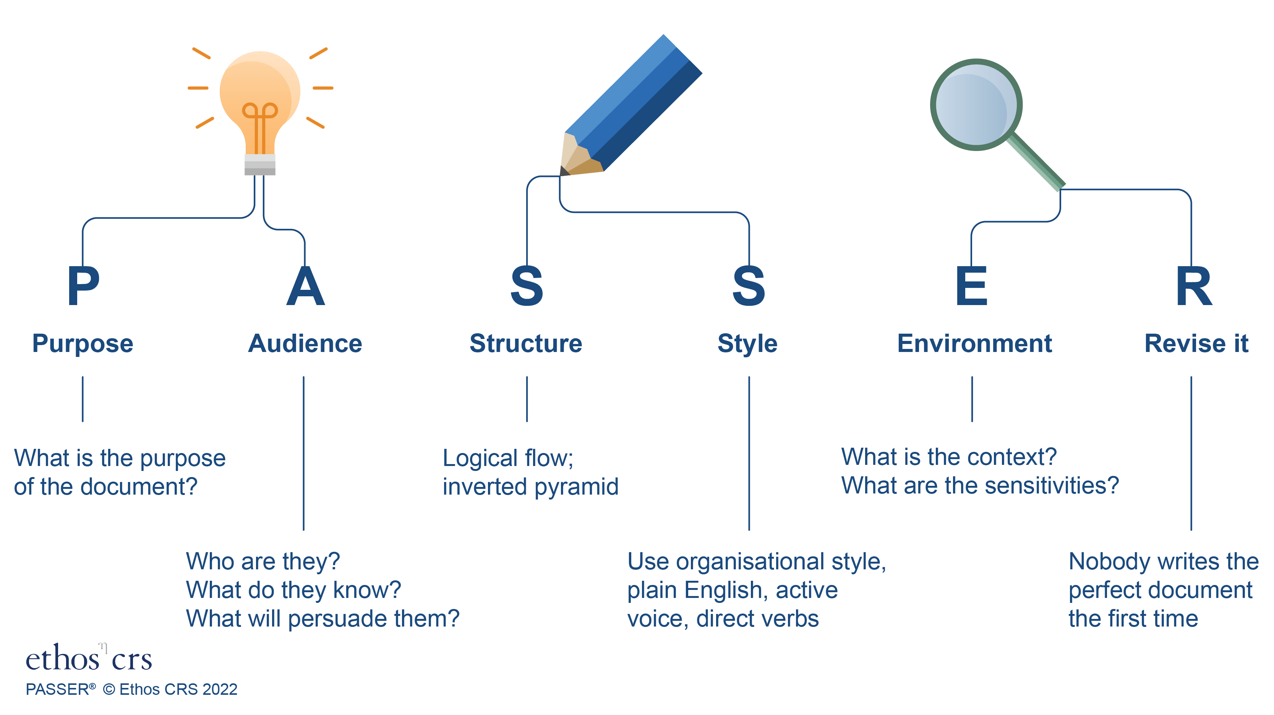

Slide 26
6. Principles of persuasion (ethos, pathos, logos)

Slide 27

3 modes of persuasion
Ethos – character
‘Trust me’.
Pathos – emotion
‘Here’s why you should care’.
Logos – logic
‘Here’s the evidence’.

Slide 28
Persuasion in action
Why flexible workplaces are better
After 15 years working across government, I’ve seen firsthand how flexible work improves team performance, retention and wellbeing. Ethos (credibility)
When people have the space to balance work and life, they show up with more energy, more focus and a genuine sense of commitment. Pathos (emotion)
Teams with flexible work options report higher productivity and 25% lower turnover, making it a clear organisational advantage. Logos (logic)

Slide 29
7. Reframing for your audiences

Slide 30
Notes:
Optional PASSER refresher – determining purpose, audience, environment is critical for establishing tone.

Slide 31
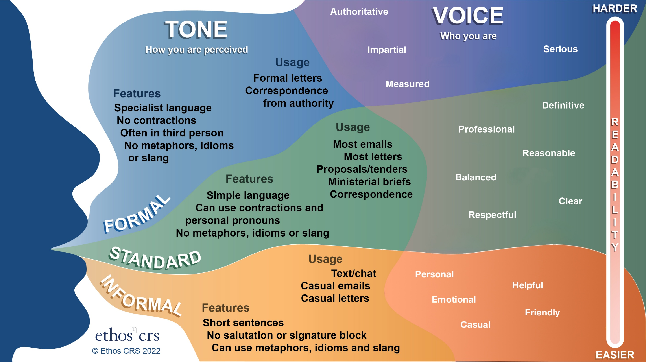

Slide 32

Strong key messages are:
clear and concise – capture one idea in simple, direct language
audience‑focused – speak to what they care about, need or must act on
memorable – use plain language and a strong, confident tone
purposeful – reinforce the core point of your communication
actionable or insightful – help the audience understand what matters or what comes next.

Slide 33
End session 1
Notes:
Before the next session, participants may wish to consider a work topic for the quick pitch activity in the workbook (activity 9)

Slide 34
Intelligent influence
Digital Transformation Agency
Session 2
Facilitator

Slide 35
8. Active listening

Slide 36

Active listening
Active listening is more than hearing what someone says.
It involves genuine curiosity, checking understanding and uncovering what matters most to the other person.

Slide 37
Aspects of active listening
Reflect on content
Look at who is talking
Withhold judgement
Be attuned to
and reflect feelings
Observe body language
Ask open-ended questions
Paraphrase
Summarise
Notes:
Active listening incorporates server practices including:
observing non-verbal body language
discerning differences between what is said and how it is said
paraphrasing key points made by a stakeholder or audience to avoid misunderstanding and ensure they feel heard.

Slide 38
9. Preparing a quick pitch

Slide 39

3-part pitch
Context – What is happening and why does it matter?
Insight – What have you observed, concluded, or identified?
Ask – What would you like the stakeholder to do?
Notes:
How can you check that your context, insight and ask are on point?
You can consider again PASSER
What’s the purpose of your pitch?
Who is your audience
assess against PASSER (particularly PAE)

Slide 40
Purpose: Is my objective clear?
Audience: Have I focused on what they care about?
Environment: Have I considered the current context?
Structure: Is my message logical and easy to follow?
Style: Does it suit the stakeholder?
Revise It: Is my ask clear, concise, and actionable?

Slide 41
10. Leveraging questions and critiques

Slide 42
3-step response
Listen – Clarify or summarise the concern
Seek to understand the concern without becoming defensive.
Reframe – Identify the issue, opportunity, or shared goal
Acknowledge the concern and position it constructively.
Respond – Adress the concern
Provide a clear response that moves the conversation forward.
Notes:
Clear communication helps others understand your idea. Active listening and thoughtful responses help others engage with it. Effective influence requires both.

Slide 43

Using questions to your advantage
Active listening and thoughtful responses influence others’ trust and willingness to listen.
The ‘right’ answer is less important than the honest answer.
Good questions may reveal blind spots – listen carefully.
Notes:
Debrief questions
Which part of the pitch was easiest to understand?
What types of questions or critiques emerged?
Which responses reduced defensiveness and increased credibility?
How did active listening influence the quality of the conversation?
At what point did you feel most influential: during the pitch or during the response?

Slide 44
Short break

Slide 45
11. Negotiation principles and styles

Slide 46
12. Resistance mapping

Slide 47

Resistance mapping answers:
Who is likely to support the change
Who may be neutral or undecided?
Who is likely to resist it?
Why are they resisting?
How influential are they?
What actions can help reduce resistance?
Notes:
Resistance mapping is a change management and stakeholder analysis technique used to identify, understand, and visualise where resistance to a proposed change is likely to come from within an organisation.
Resistance mapping helps organisations:
Anticipate obstacles before implementation
Focus engagement efforts on the right people
Improve adoption rates
Reduce project delays
Build stronger change management plans

Slide 48

Revealing common causes of resistance
Fear of losing control or status
Lack of understanding of the change
Concern about increased workload
Past negative experiences with change initiatives
Uncertainty about future roles or job security
Misalignment with personal or team goals
Notes:
Resistance mapping reveals deeper concerns – not just what’s on the surface

Slide 49
13. Planning a stakeholder engagement meeting

Slide 50
14. Creating an influencing culture

Slide 51

Influencing together
Share lessons learned
Hold team meetings
Provide training
Encourage collaboration
Use a common influencing framework
Plan for stakeholder meetings
Debrief following difficult conversations
Share successful pitches or approaches

Slide 52
15. Protecting influence under pressure

Slide 53
Your feedback is important to us
Thank you for taking a moment to fill out the evaluation form.
Your facilitator or department contact will share the link with you.
Notes:
Your feedback is really important!
FACILITATORS – IF WE DISTRIBUTE THE LINKS, THEY CAN BE FOUND IN THE CALENDAR EVENT. PLEASE COPY AND PASTE THIS LINK INTO THE CHAT NOW.
Otherwise the calendar event should indicate if the evals are self administrated through the client contact.

Slide 54
Thank you!
Any questions?

